Slide 1
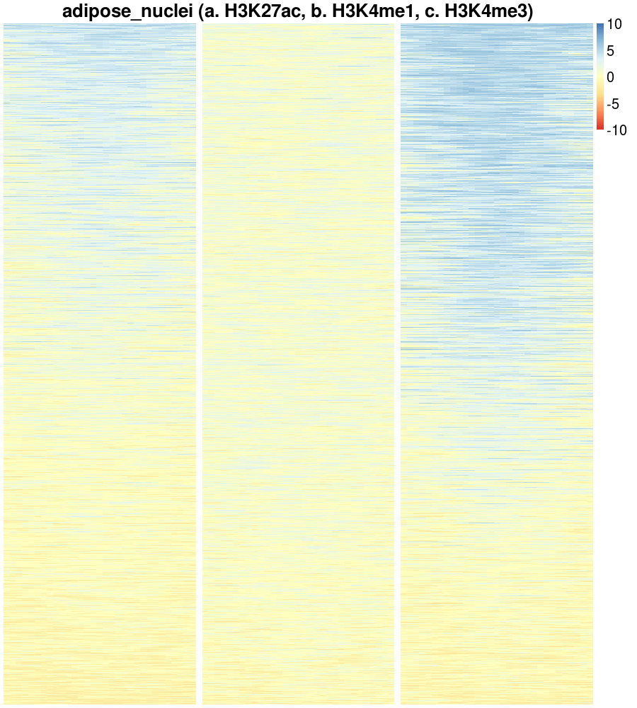
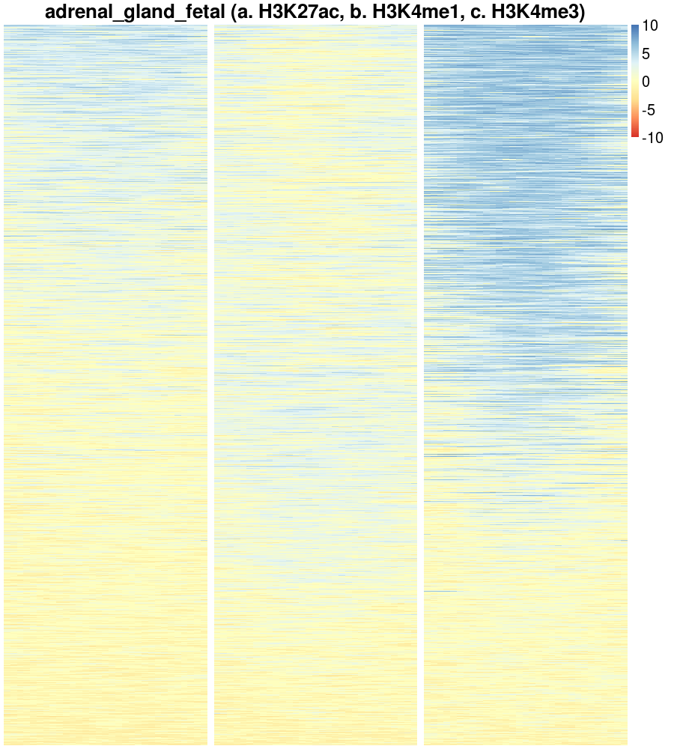
Input normalized
RPKM
-800 0 800
-800 0 800
-800 0 800
-800 0 800
-800 0 800
-800 0 800

Slide 2
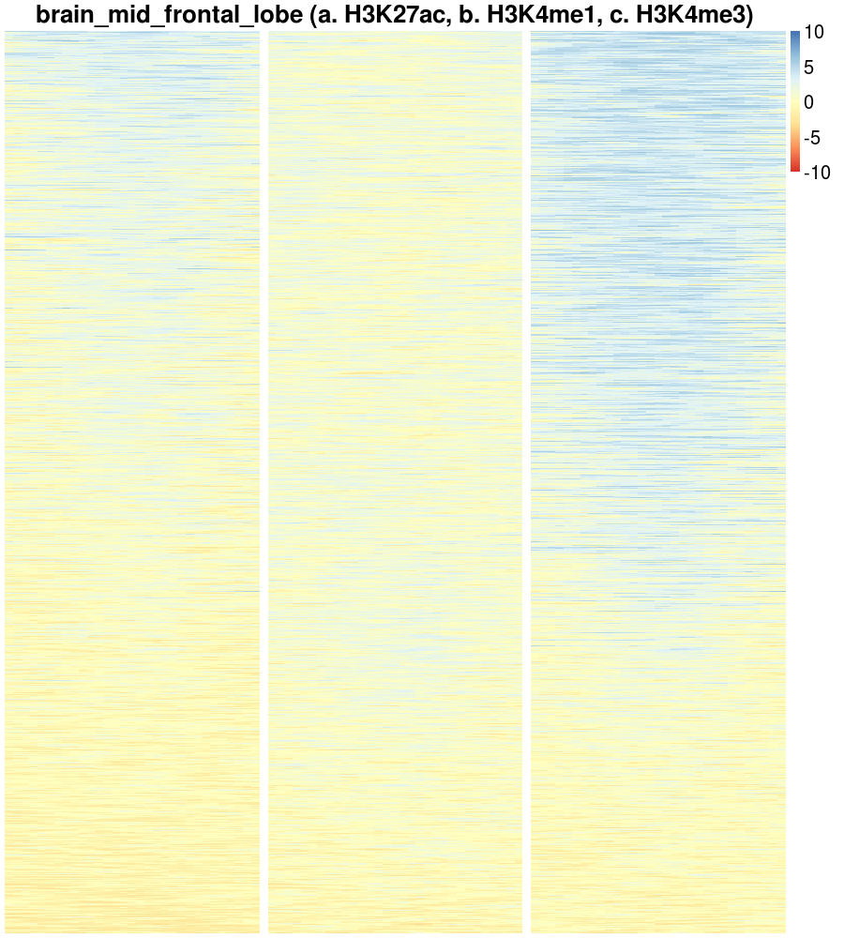
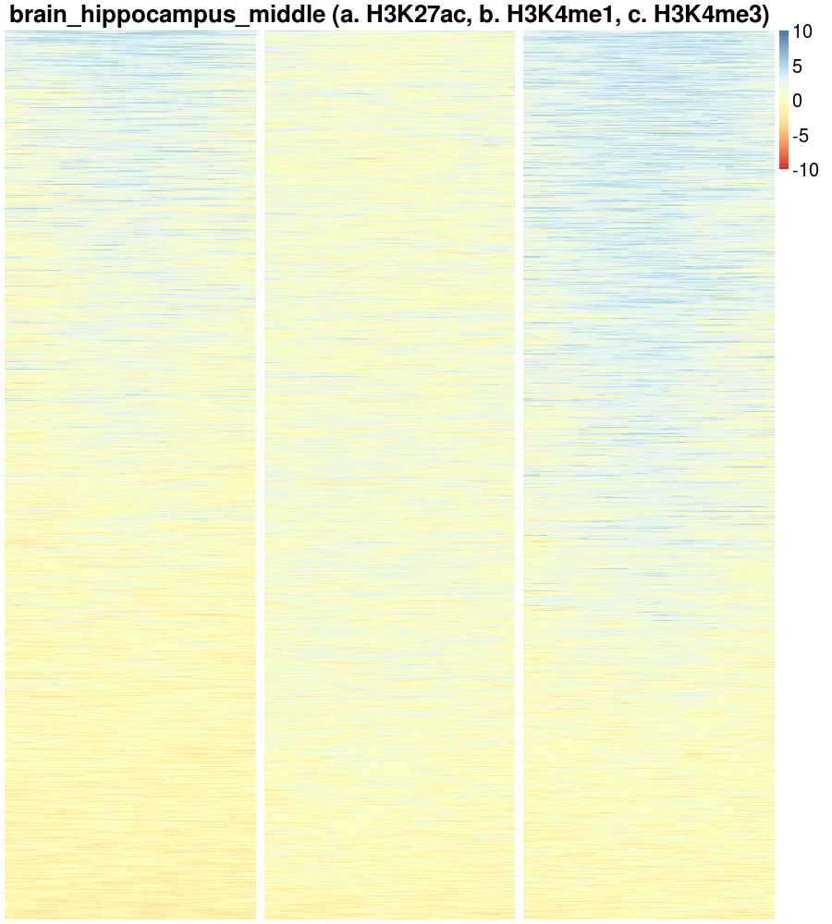
-800 0 800
-800 0 800
-800 0 800
-800 0 800
-800 0 800
-800 0 800

Slide 3
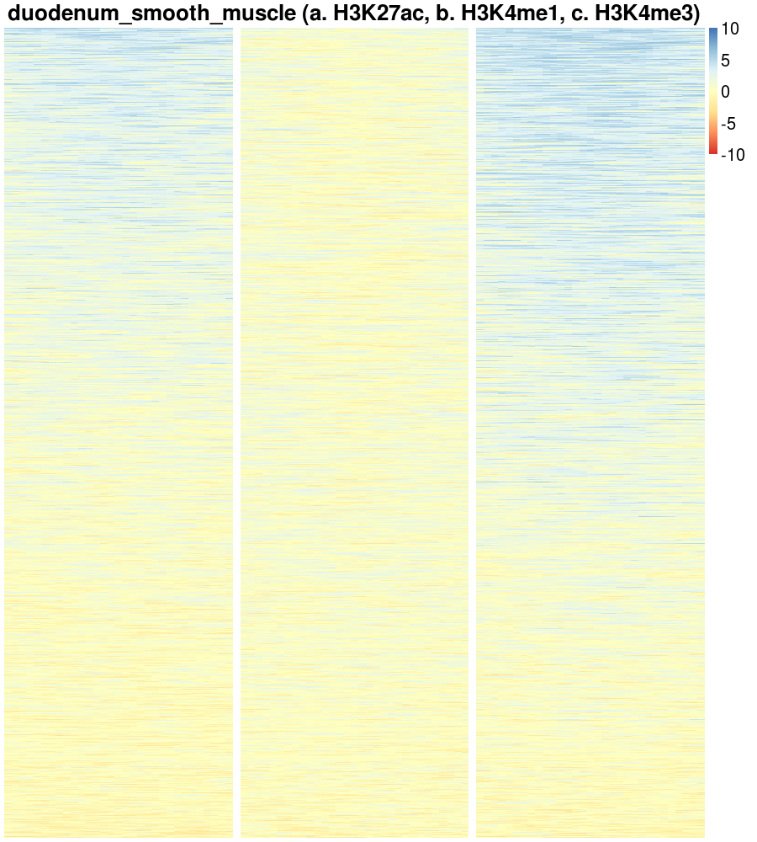
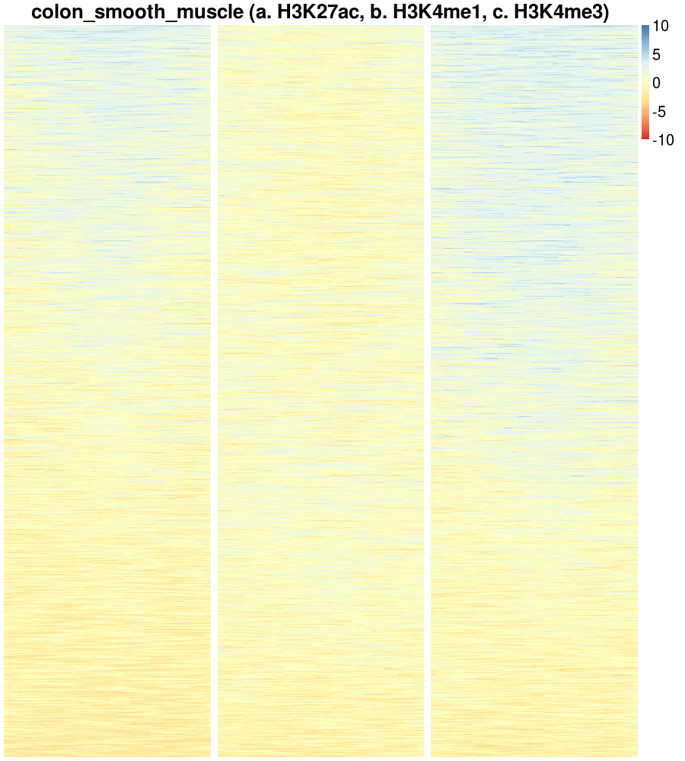
-800 0 800
-800 0 800
-800 0 800
-800 0 800
-800 0 800
-800 0 800

Slide 4
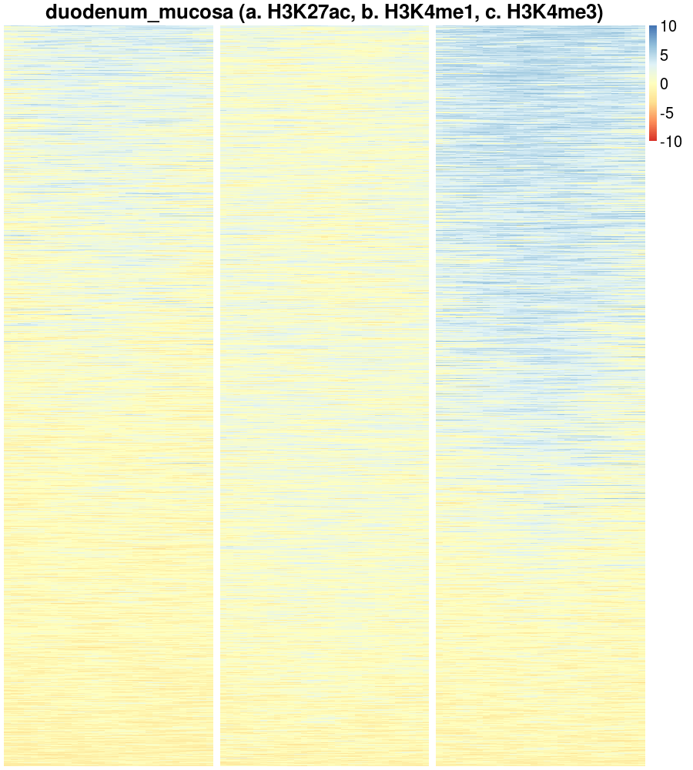
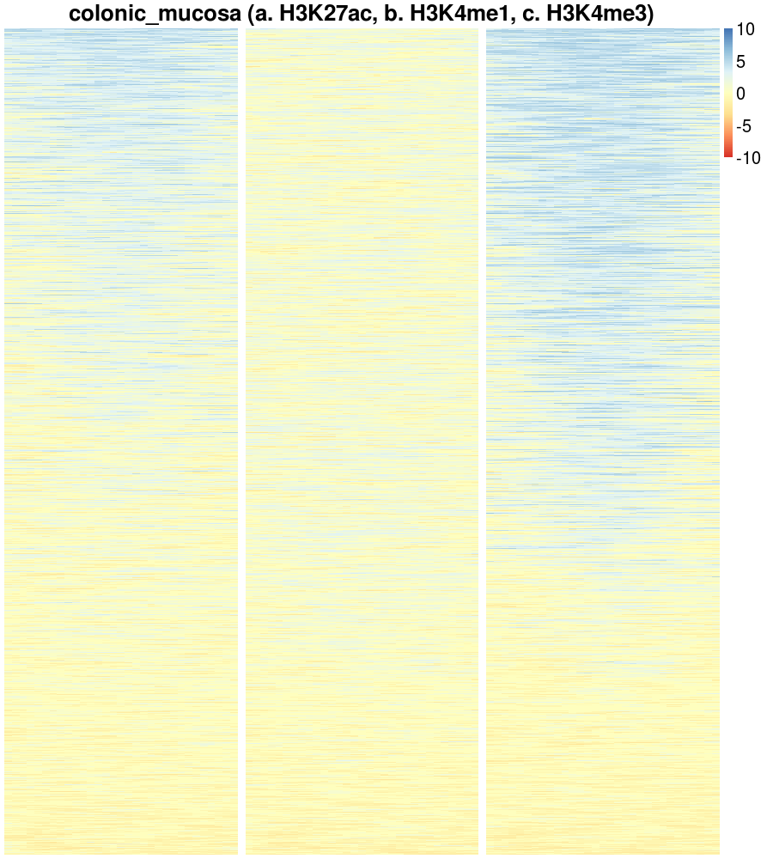
-800 0 800
-800 0 800
-800 0 800
-800 0 800
-800 0 800
-800 0 800

Slide 5
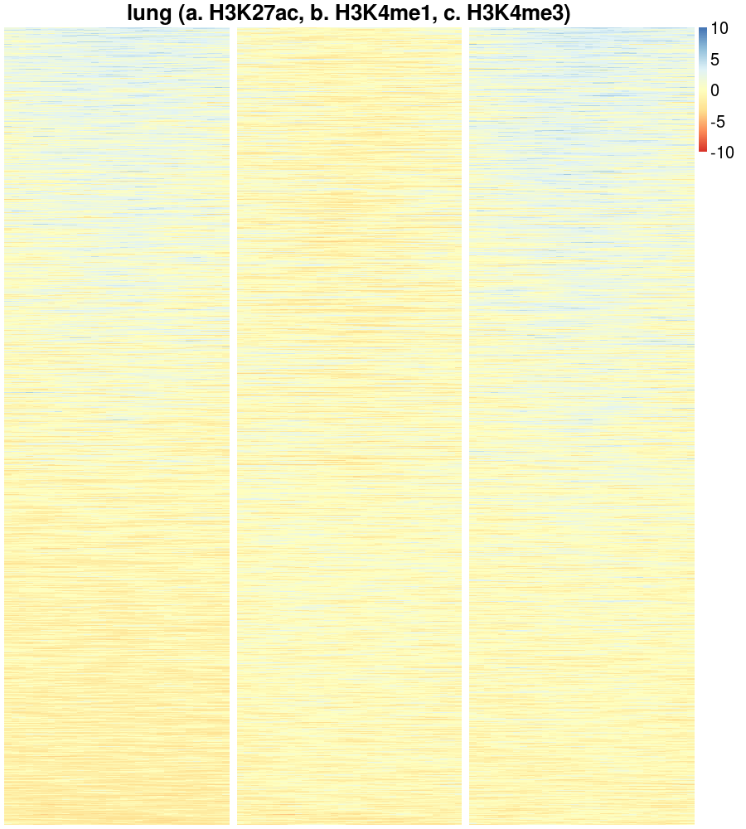
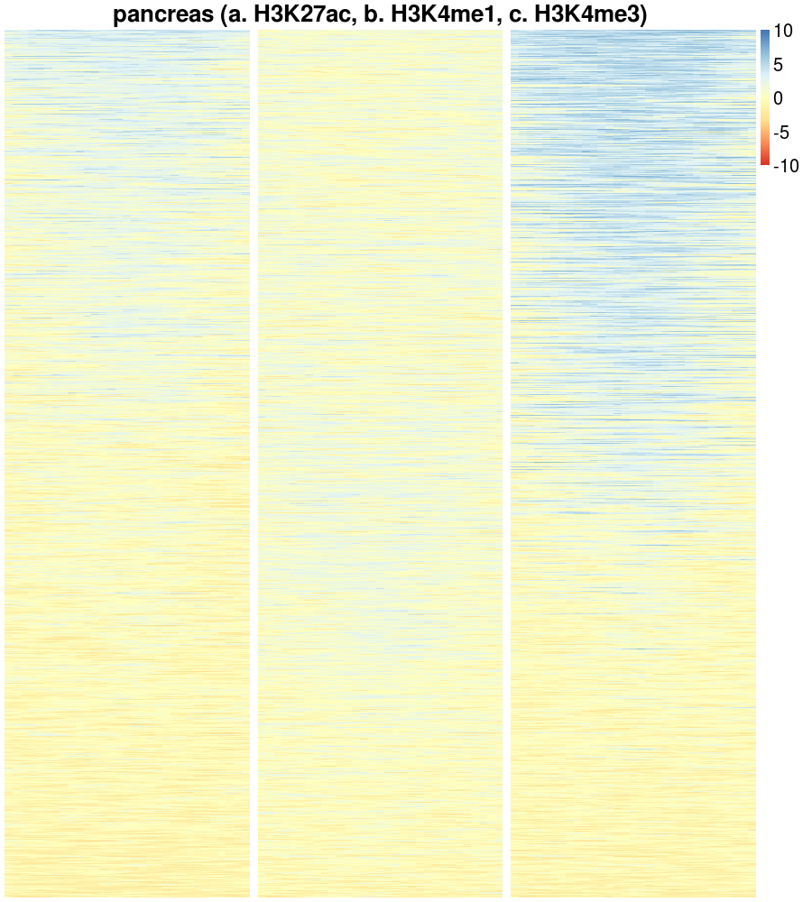
-800 0 800
-800 0 800
-800 0 800
-800 0 800
-800 0 800
-800 0 800

Slide 6
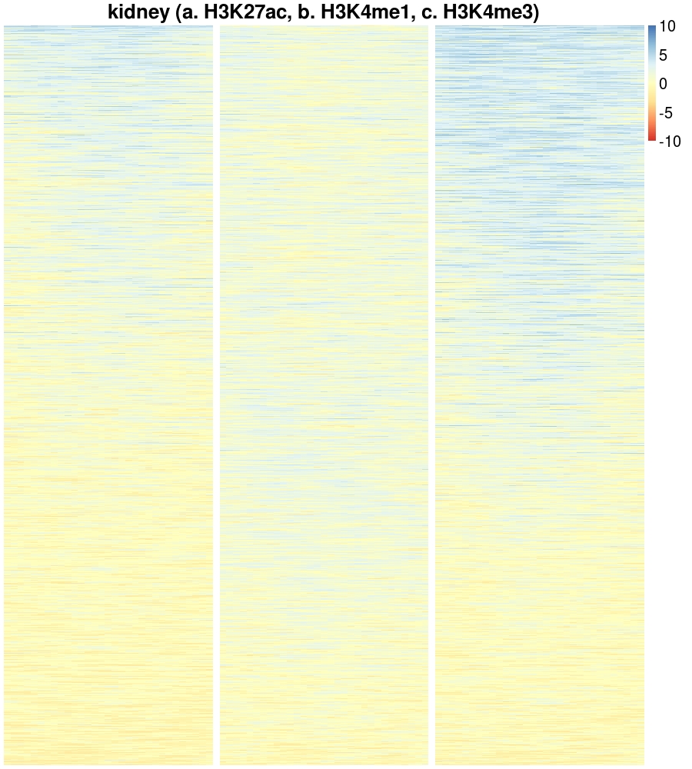
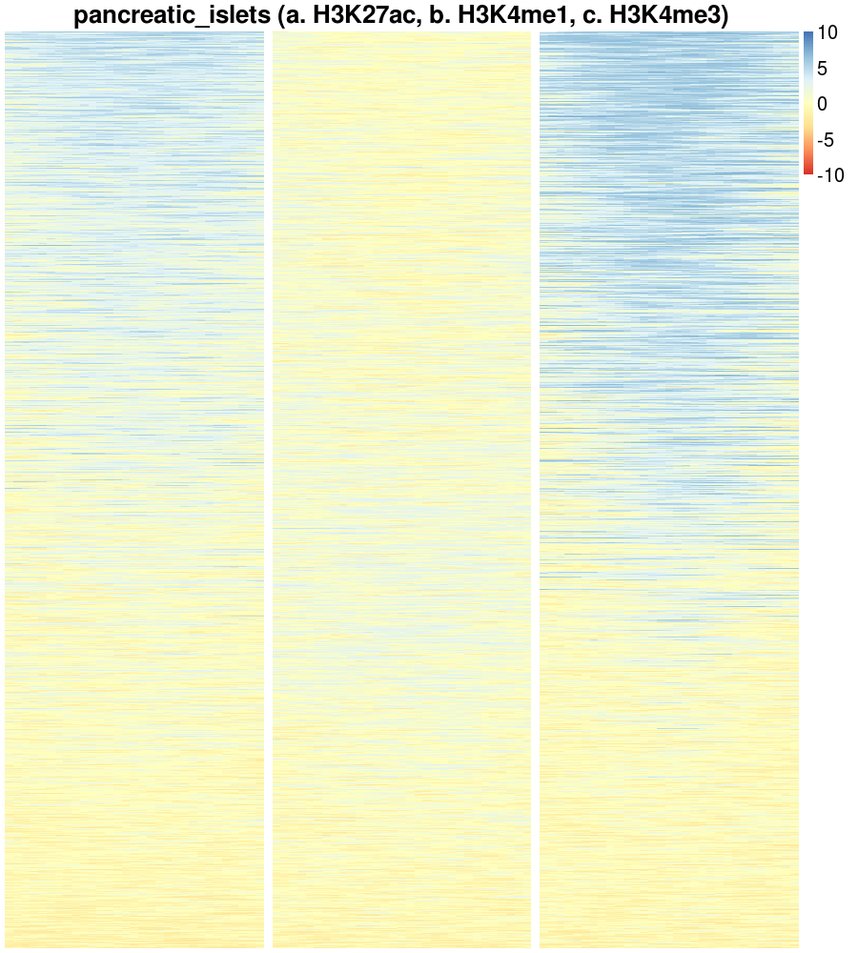
-800 0 800
-800 0 800
-800 0 800
-800 0 800
-800 0 800
-800 0 800

